Slide 1
Performance Evaluation: CUDA GPU vs. OpenMP CPU
Garrett A. DiPalma, Nicholas Guerra, Jacob Johnson

Slide 2
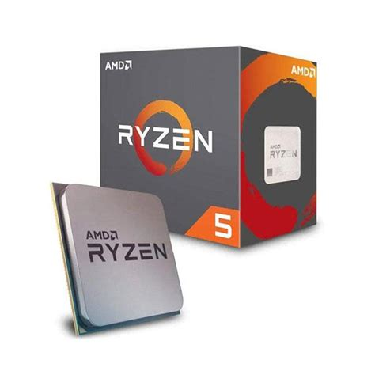
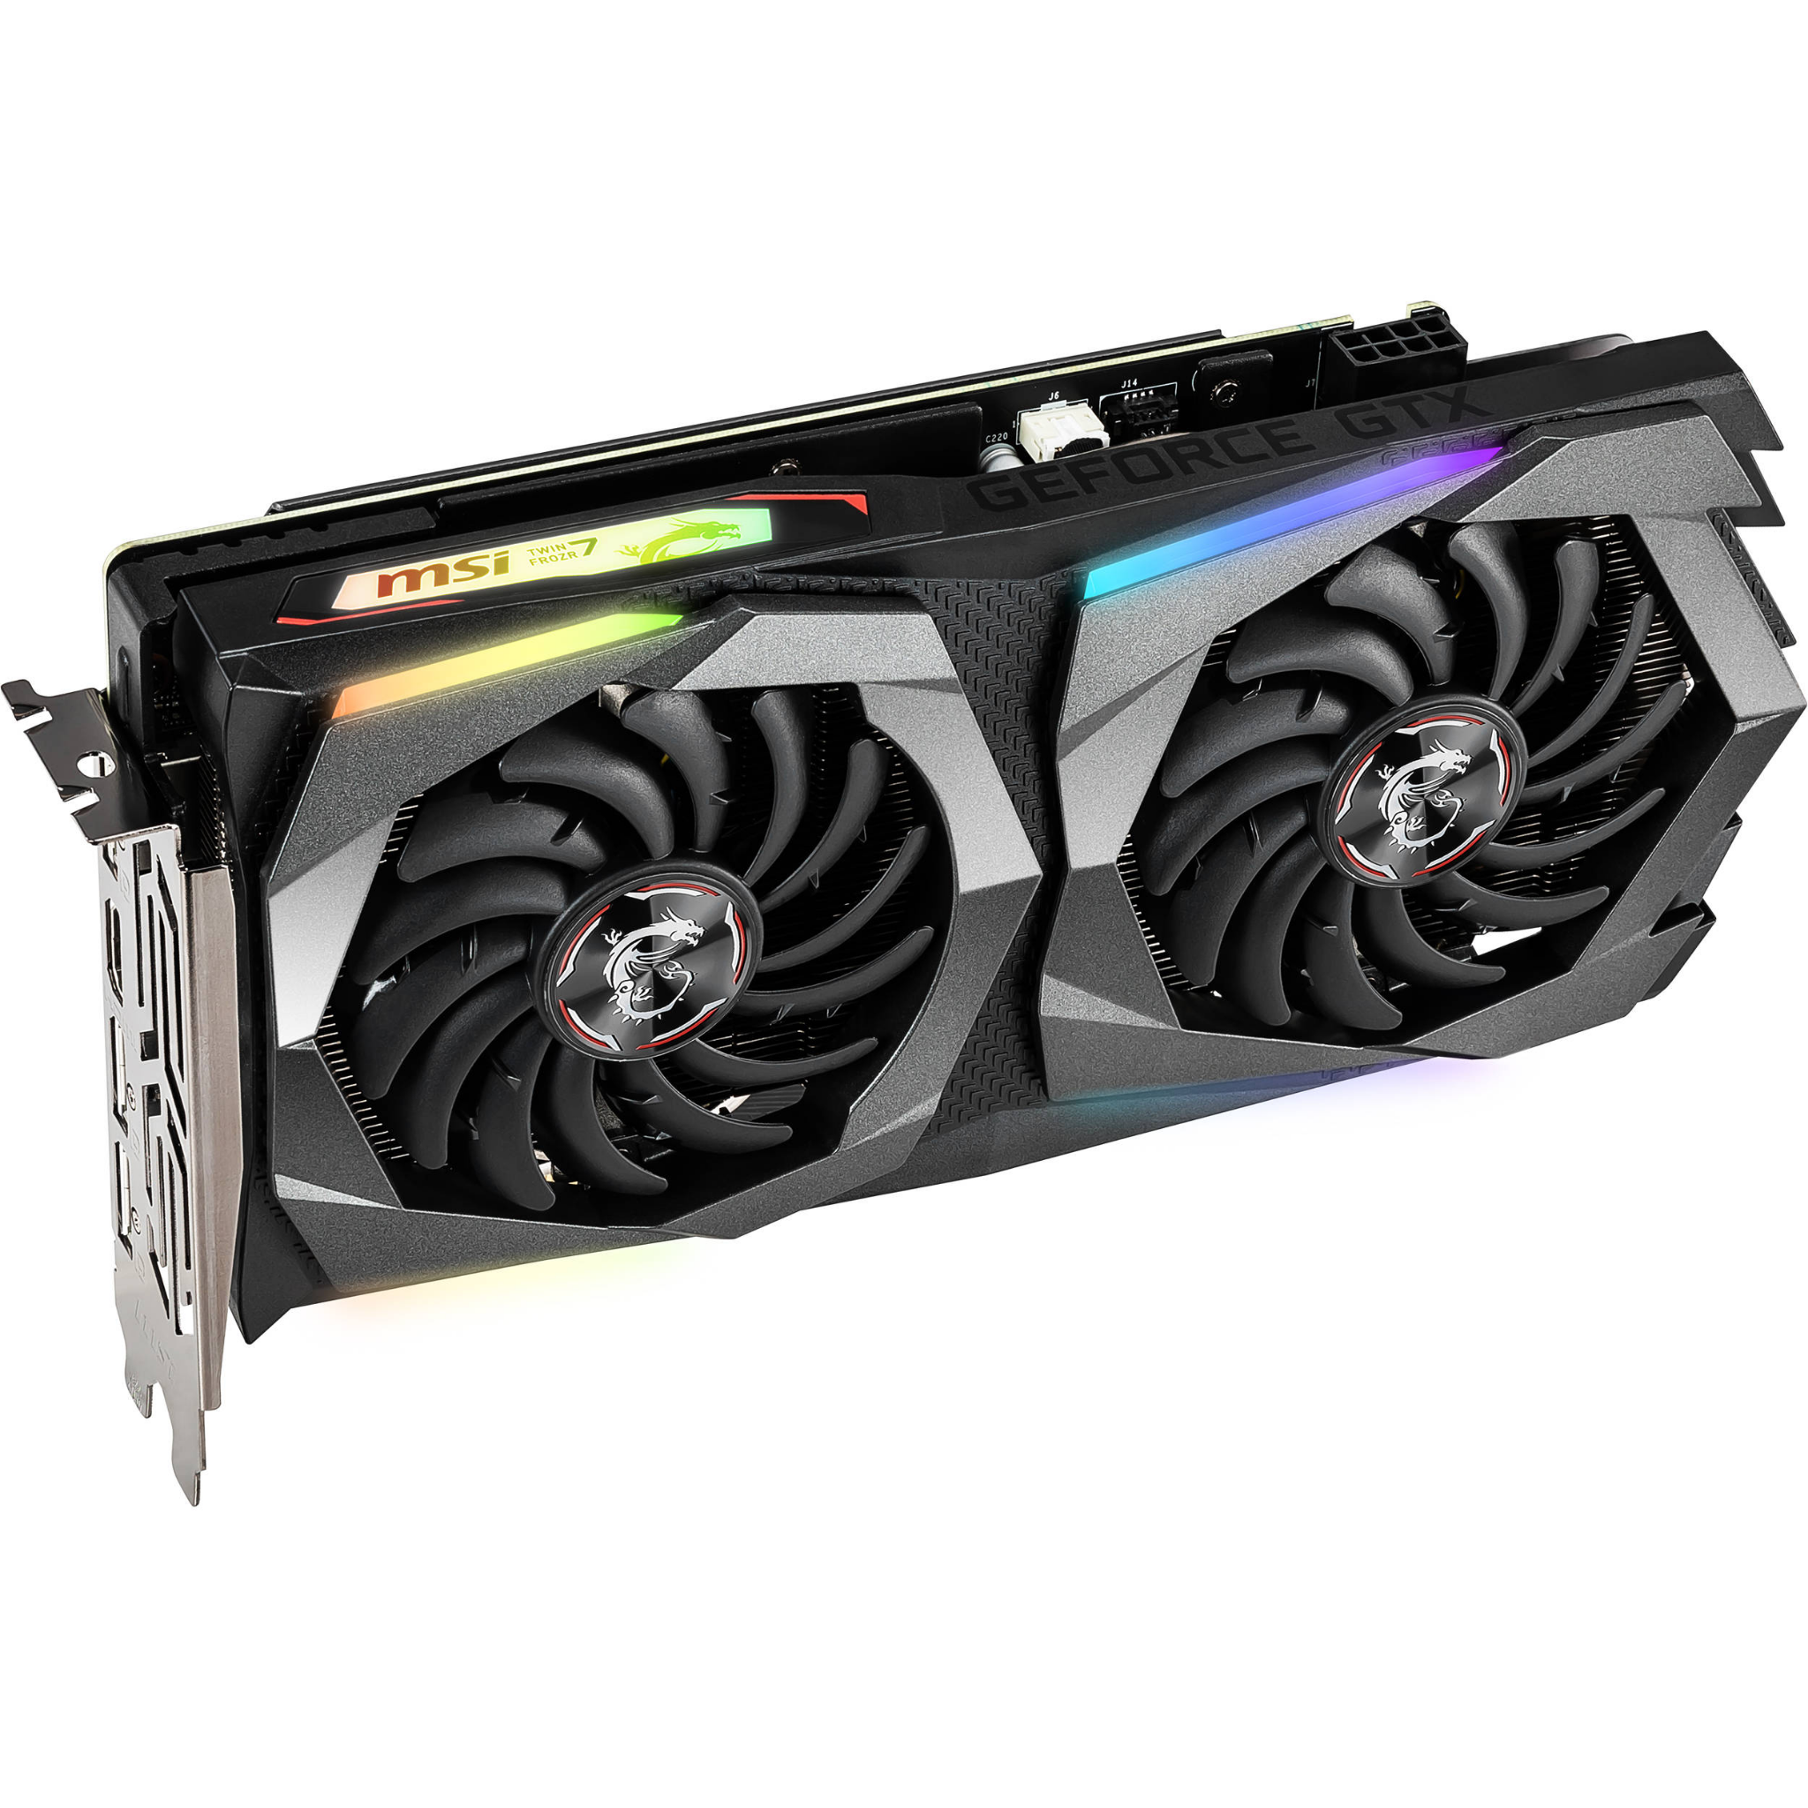
Introduction: CUDA GPU vs. CPU
Brief Project Overview
Initial Hypothesis/Expectations
vs.
Notes:
Project overview:
4 CPU programs converted into CUDA implementations and a performance evaluation between a GPU running CUDA architecture and an OpenMP CPU, comparing metrics like ExecTime, CPI, and cache-performance. 1 program being sequential rather than parallel.
Hypothesis:
our hypothesis was that the GPU would outperform the CPU on every program until the parameters exceeded the GPUs memory capabilities

Slide 3


History of CUDA and OpenMP
CUDA architecture is a parallel computing platform developed in 2003 by Nvidia for general-purpose computing on Nvidia’s own GPU’s
OpenMP is a multi-platform shared-memory for parallel programming in C and C++ created in 1997.
vs.

Slide 4
Tools and Specs
 | CPU | GPU
Name | AMD Ryzen 5 2600 | Nvidia GTX 1660 Ti
Cores | 6 | 1536
Threads | 12 | 1,572,864
Clock Speed (MHz) | 3900 | 1785
Cache (KB) | L1: 576 L2: 3000 L3: 16000 | L1: 64 L2:1536
Memory | RAM: 16 GB | GRAM: 6 GB
Parallelism | OpenMP | CUDA
Architecture | Zen | Turing
Power | 65W | 120W
Price | $195 | $300
knapsack.c
matrixMul.cu
vectorAdd.cu
gradeChecker.cu
perf
gcc
nvcc
nvprof
Nsight compute
Notes:
Perf stat: Linux tool to show performance metrics
gcc: C compiler, used to compile .c files
nvcc: CUDA compiler, used to compile .cu files
Nsight Compute: Similar to perf, used to collect performance metrics
nvprof: Similar to perf, used to collect, percentage wise, GPU and CPU API calls and elapsed program time

Slide 5
General Project Methodology
Rewriting Programs:
Gathering performance data
Analyzing and graphing performance metrics
Notes:
Rewriting programs:
We took the C code and rewrote it CUDA code
We had to use CUDA block parallelism for .cu files while we used OpenMP for CPU thread parallelism
Gathar Data:
Ran perf stat, nvprof, and nsight compute multiple times to get metrics like elapsed time, cycles, and cache metrics
Analyzing performance:
Took the raw data into a spreadsheet and created charts to compare CPU and GPU metrics

Slide 6
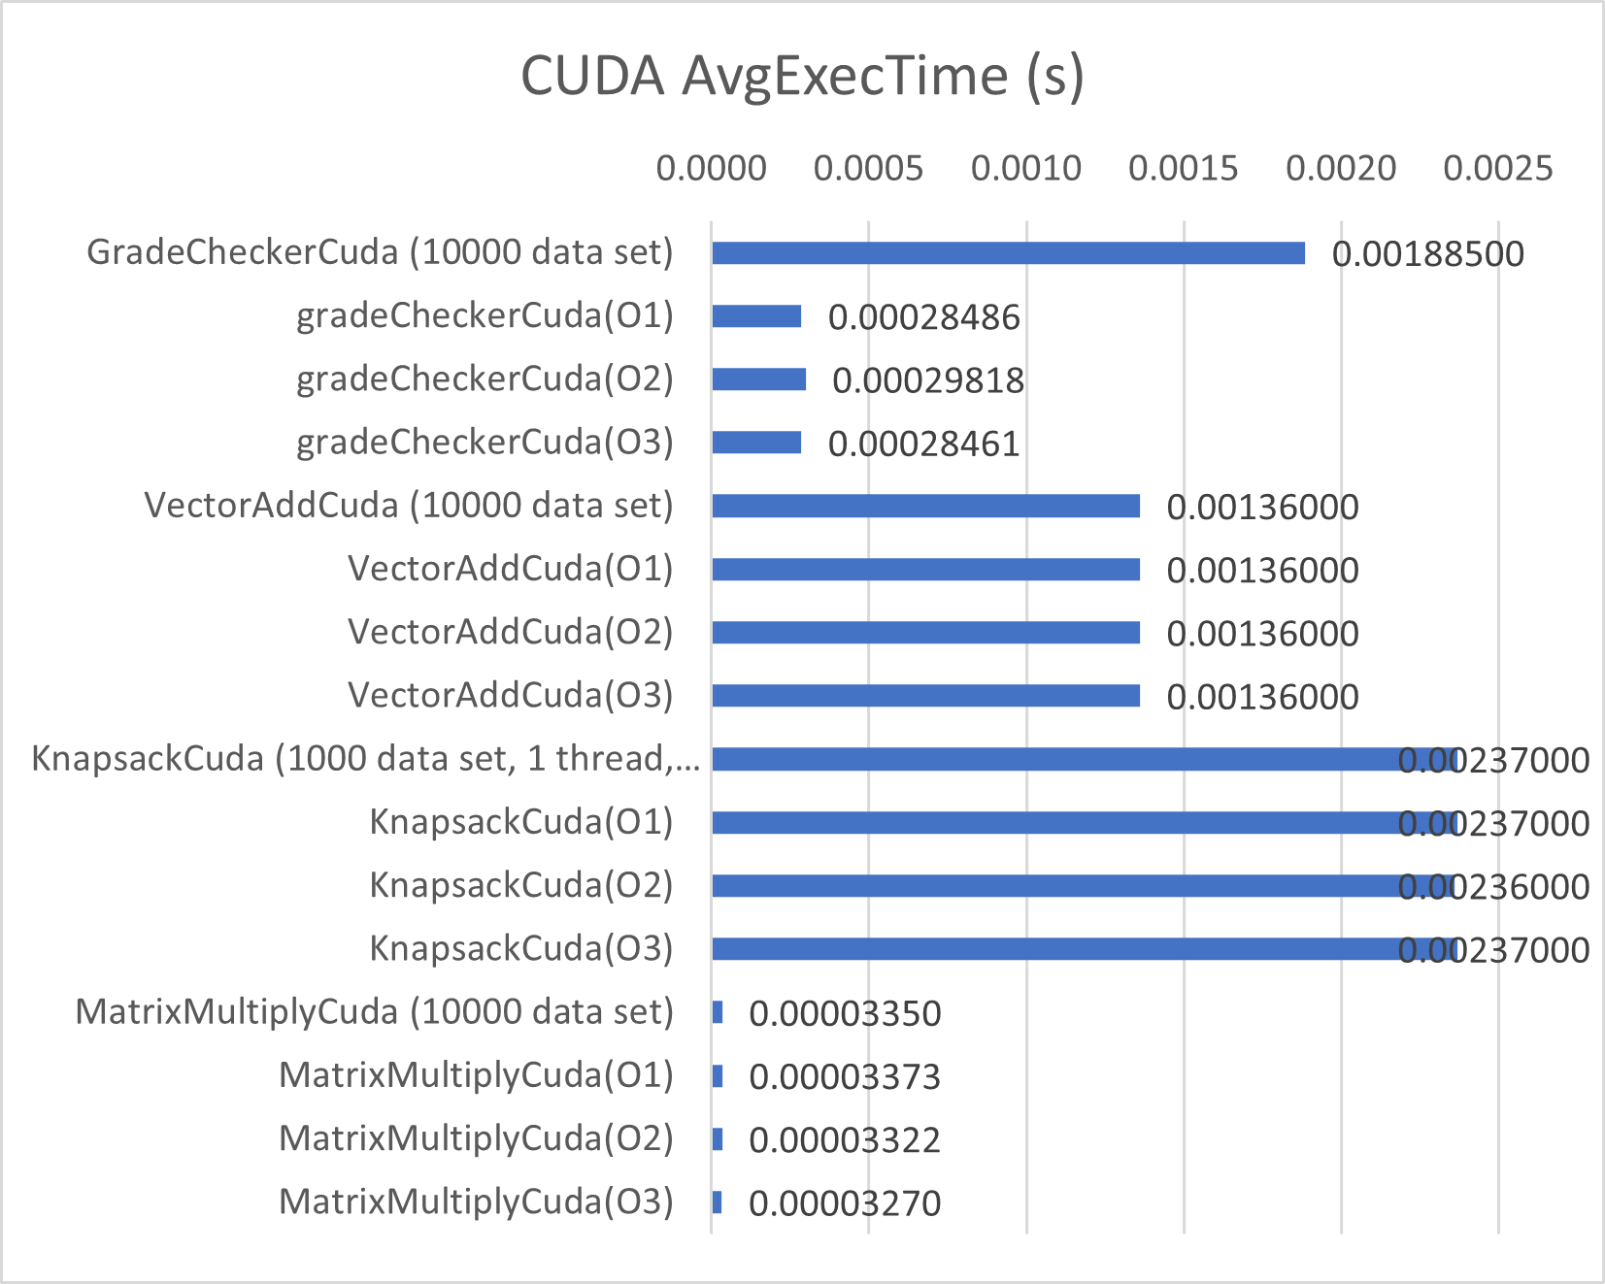
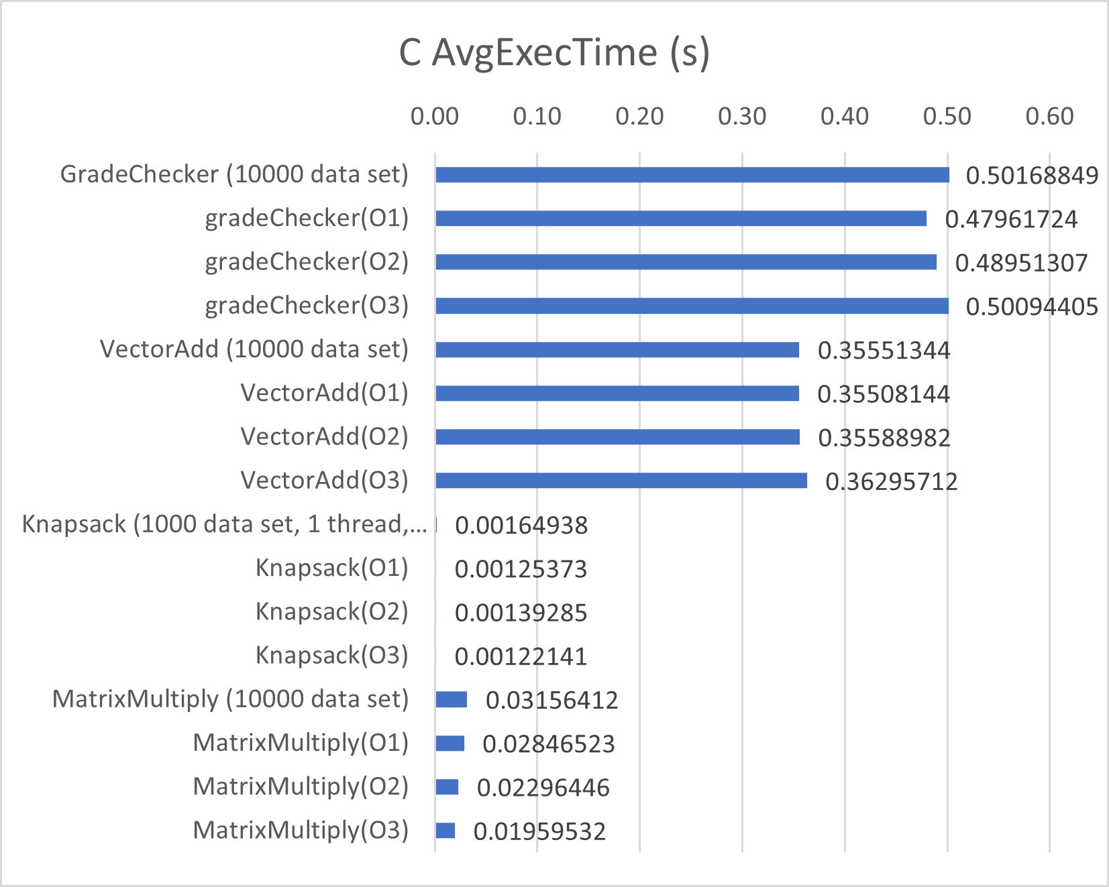
Results and Performance Metrics Graphs
Notes:
In the comparison of C and CUDA, the CUDA programs have an average execution time about 100 times to 1000 times faster than the CPU programs.

Slide 7
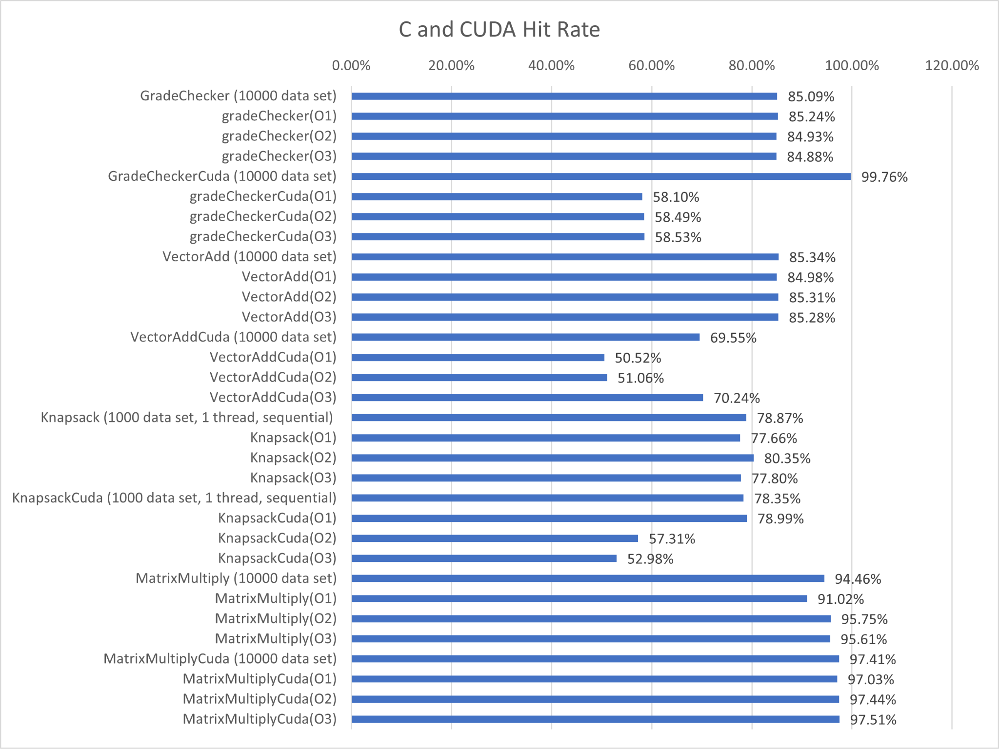
Results and Performance Metrics Graphs
Notes:
In comparing cache hit rates, the cuda programs have a lower hit rate and therefore a higher cache miss rate

Slide 8
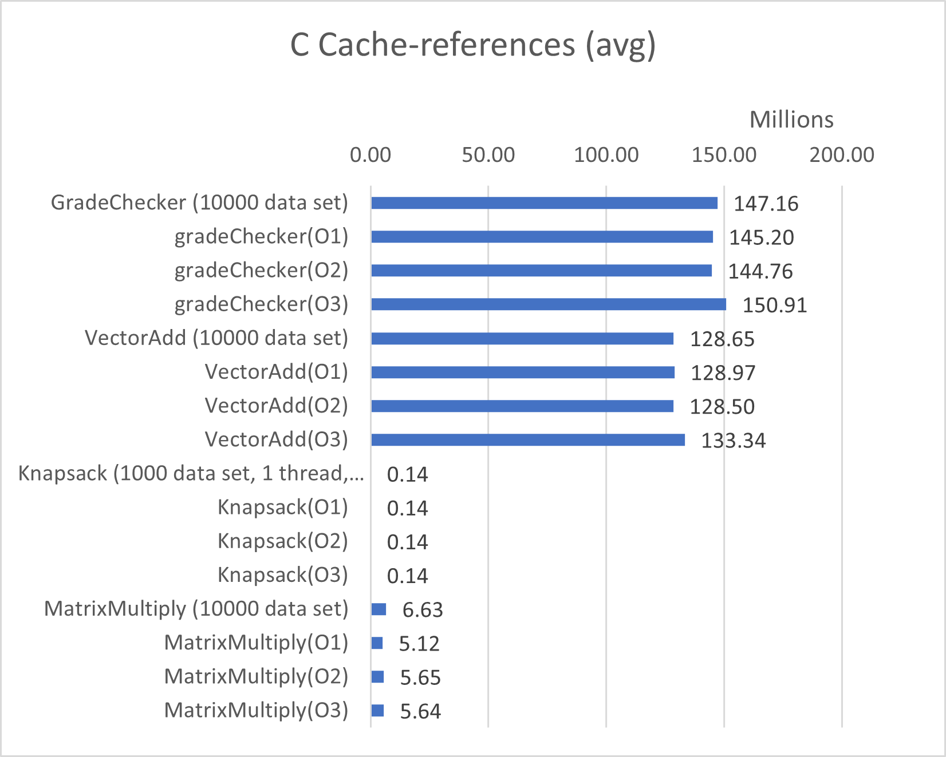
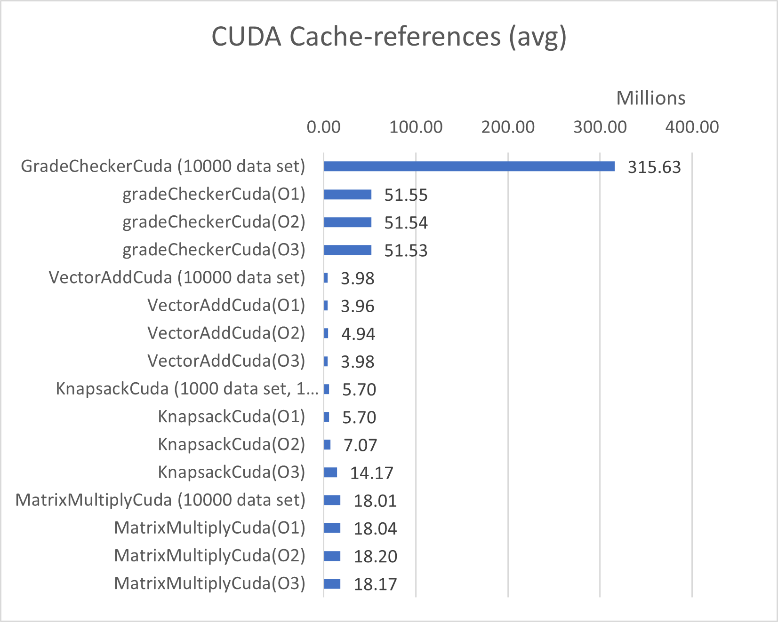
Results and Performance Metrics Graphs
Notes:
However, the CPU uses on average more cache than the GPU. This is because the CPU has 3 levels of caches that are larger than the 2 levels of caches on the GPU

Slide 9
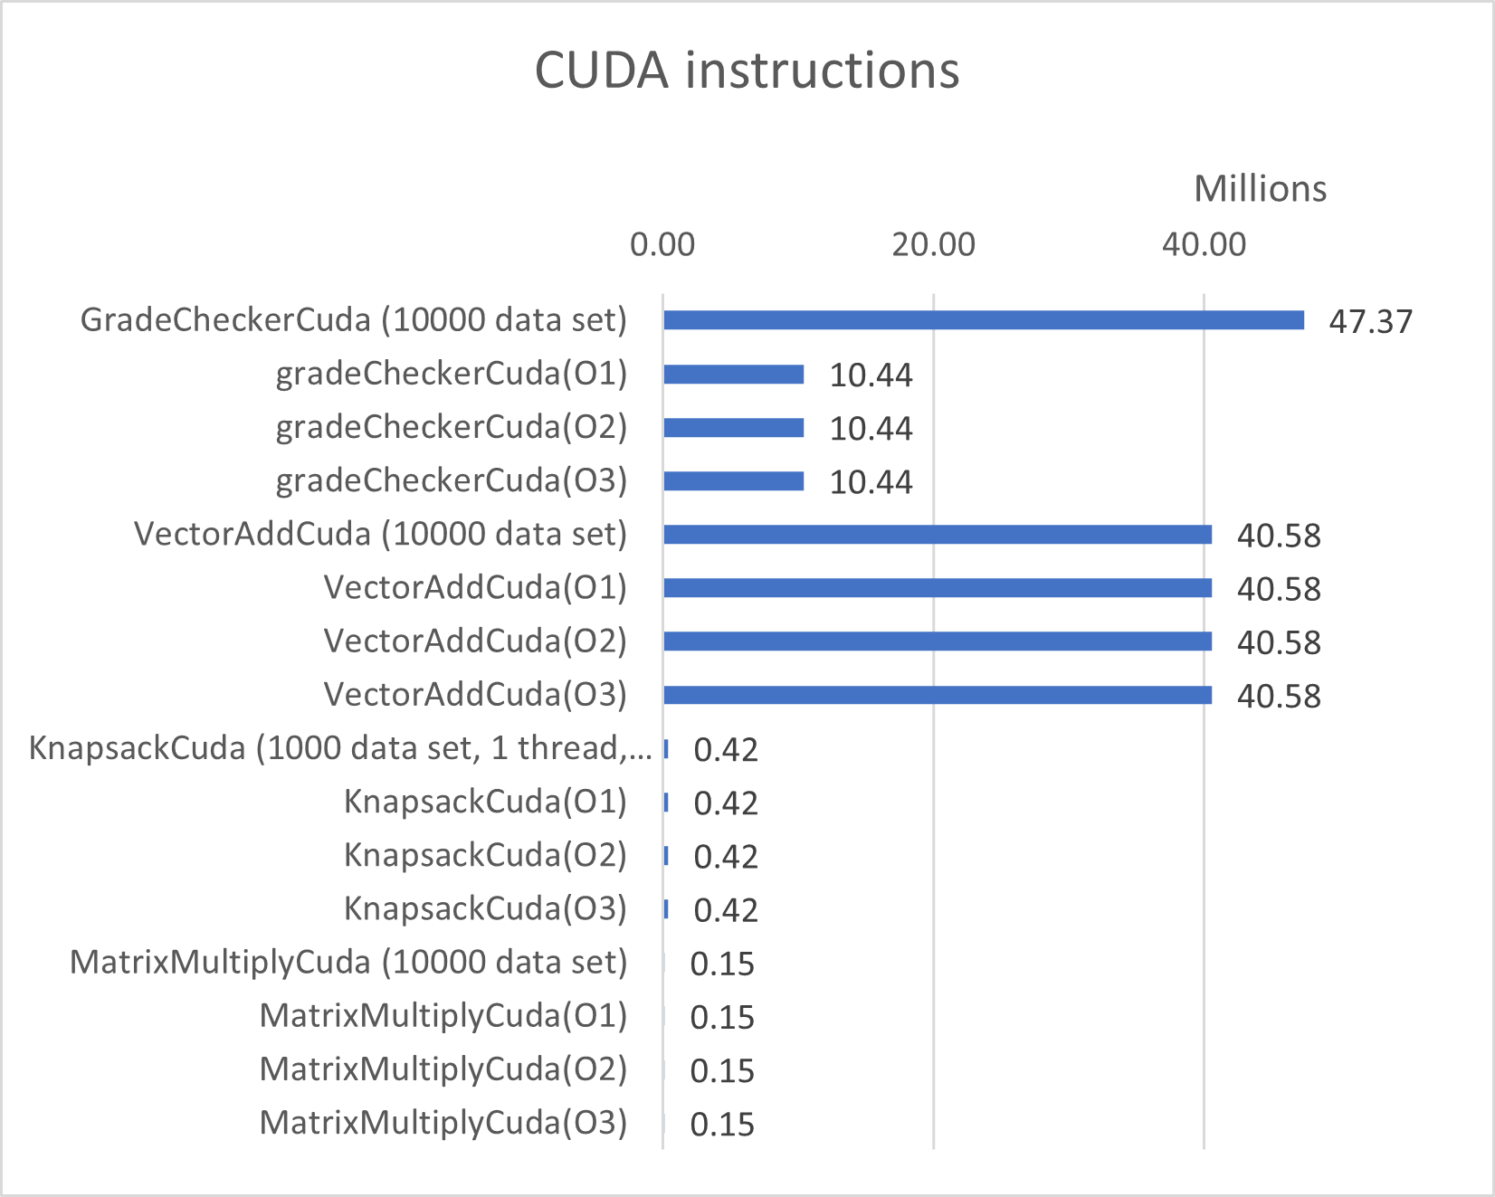
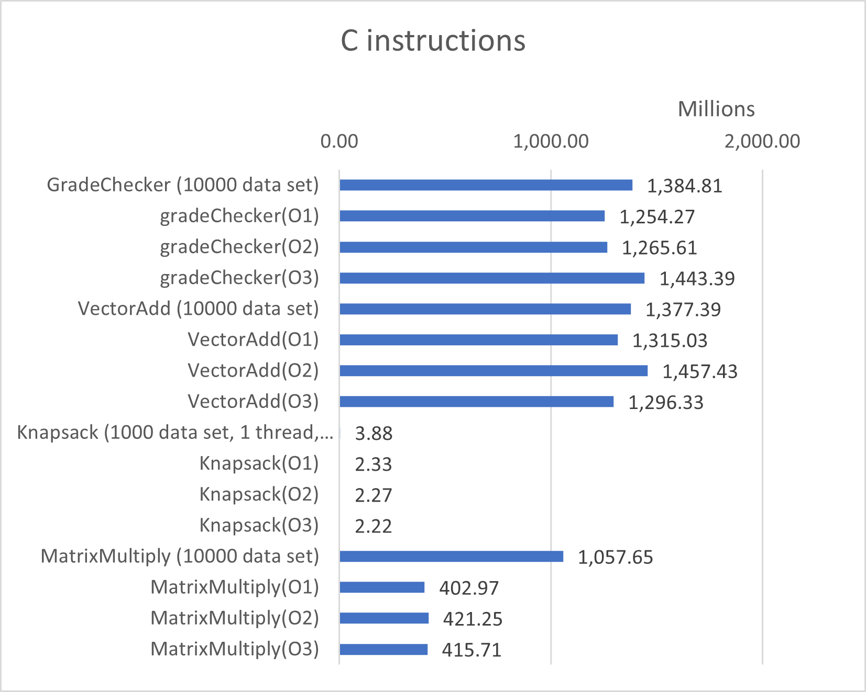
Results and Performance Metrics Graphs
Notes:
The CUDA code has on average 15 million instructions, while the C code has 818 million instructions. This result means the gcc compiler is making about 55 times more instructions than the CUDA nvcc compilier

Slide 10
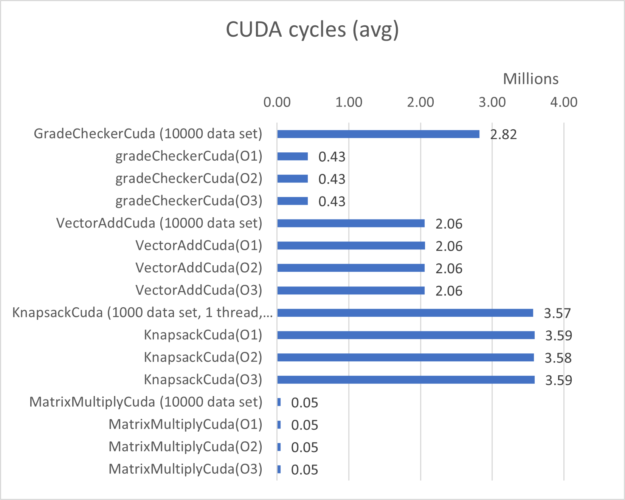
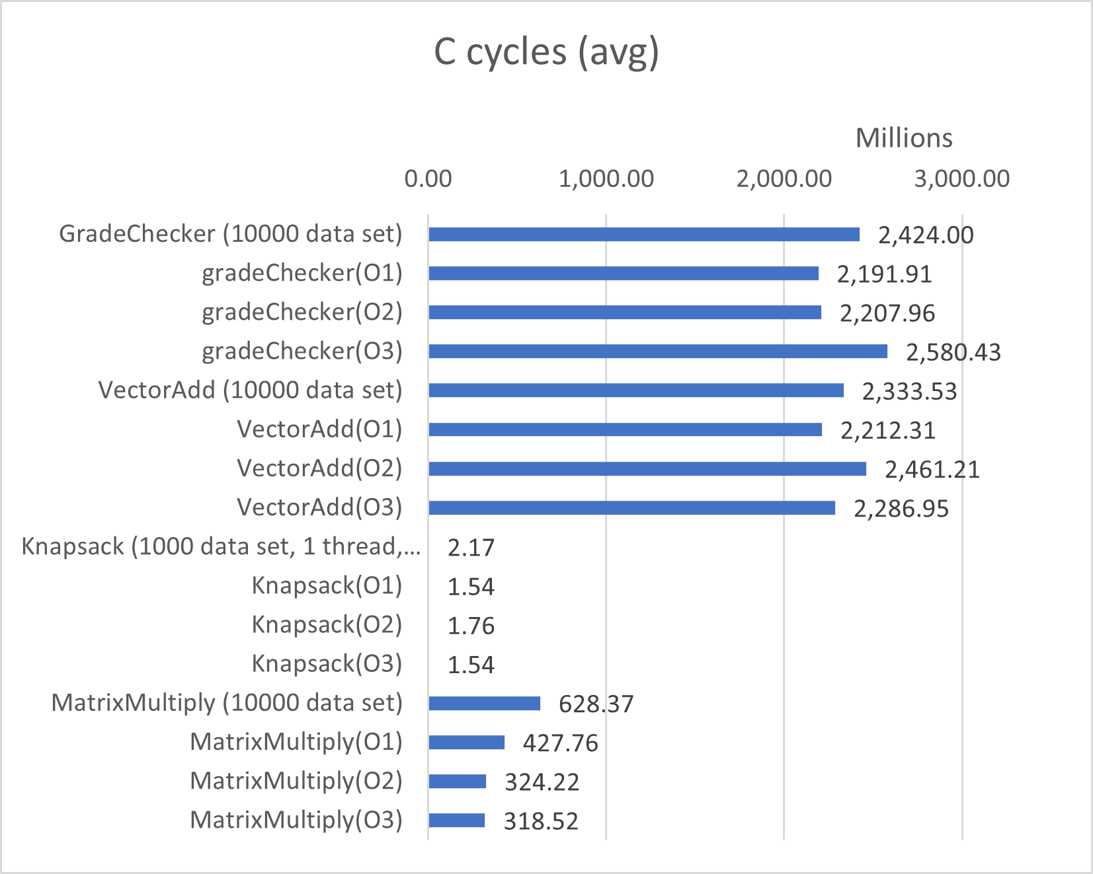
Results and Performance Metrics Graphs
Notes:
The CUDA nvcc compiler uses on average 2 million cycles while the gcc -openmp uses on average 1150 million cycles, The CPU creates almost 600 times more cycles than the GPU.

Slide 11


Conclusion
GPU performs 57% better than the CPU across our metrics
Knapsack anomaly
Cost performance example
or
Notes:
GPU performance:
The GPU performs better in execution time and CPI, however because of the small cache size, the GPU had lower hit rates
Knapsack:
Knapsack compared the performance of a single thread, on the GPU and CPU. This showed us that while the GPU was out performing the CPU in parallel, it was doing so because the GPU had more threads. The CPU had better performing threads, this is also because the clock rate applied for the CPU is twice as much as the GPU clock rate
Cost/Performance:
On conclusion stands; If you would take an example of 2 programs running on a machine daily in Austin, the GPU executing the program is almost 500,000 times cheaper per kWh than the CPU program.

